Slide 1
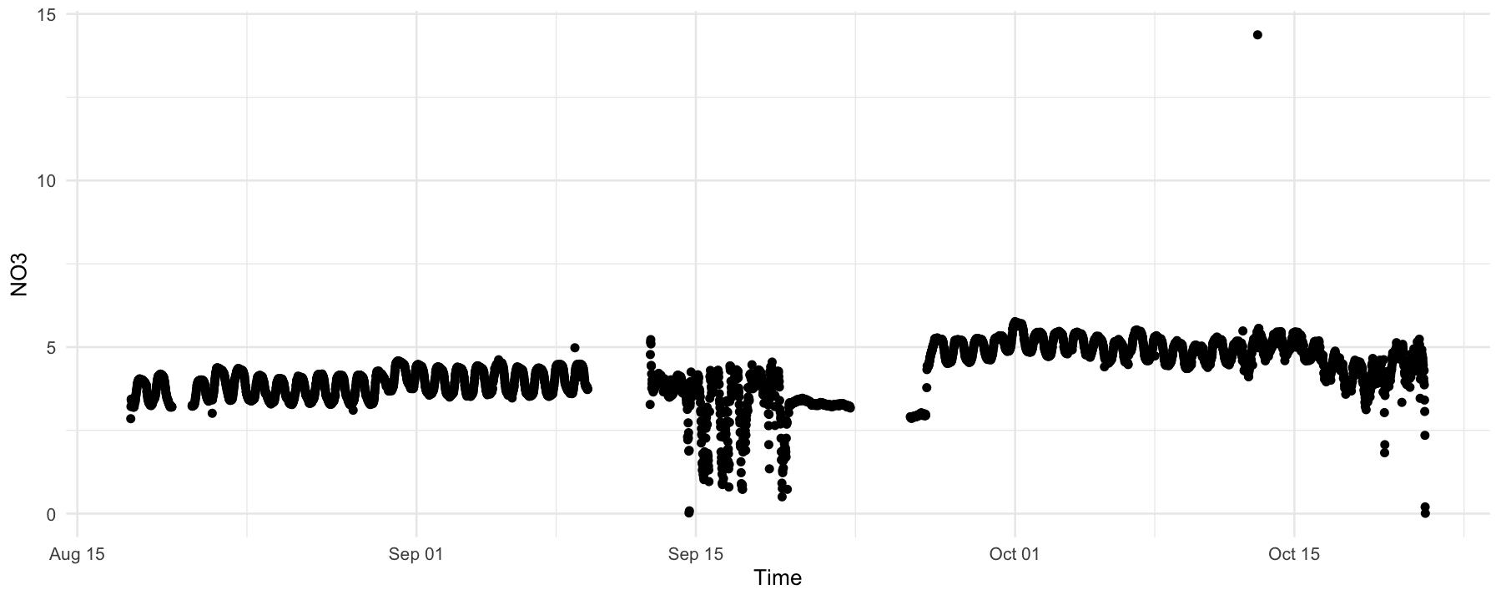
SUNA timeseries – Nyack floodplain
Spring
pool
Middle Fork

